Slide 1
MODULE 4

Slide 2
Dimensionality reduction
Dimensionality reduction is an important approach in machine learning.
A large number of features available in the dataset may result in overfitting of the learning model.
To identify the set of significant features and to reduce the dimension of the dataset, dimensionality reduction techniques that are used.

Slide 3
Dimensionality reduction technique can be defined as, "It is a way of converting the higher dimensions dataset into lesser dimensions dataset ensuring that it provides similar information."
These techniques are widely used in machine learning for obtaining a better fit predictive model while solving the classification and regression problems.

Slide 4
The number of input features, variables, or columns present in a given dataset is known as dimensionality.
Process to reduce these features is called dimensionality reduction.
A dataset contains a huge number of input features in various cases, which makes the predictive modeling task more complicated.
Because it is very difficult to visualize or make predictions for the training dataset with a high number of features, for such cases, dimensionality reduction techniques are required to use.

Slide 5
Benefits of applying Dimensionality Reduction
By reducing the dimensions of the features, the space required to store the dataset also gets reduced.
Less Computation training time is required for reduced dimensions of features.
Reduced dimensions of features of the dataset help in visualizing the data quickly.
It removes the redundant features (if present) by taking care of multi-collinearity.

Slide 6
Disadvantages of dimensionality Reduction
Some data may be lost due to dimensionality reduction.
In the PCA dimensionality reduction technique, sometimes the principal components required to consider are unknown.

Slide 7
Approaches of Dimension Reduction
There are two ways to apply the dimension reduction technique:
Feature Selection
Feature selection is the process of selecting the subset of the relevant features and leaving out the irrelevant features present in a dataset to build a model of high accuracy.
In other words, it is a way of selecting the optimal features from the input dataset.
Three methods are used for the feature selection:
1. Filters Methods
In this method, the dataset is filtered, and a subset that contains only the relevant features is taken. Some common techniques of filters method are:
Correlation
Chi-Square Test
ANOVA
Information Gain, etc.

Slide 8
2. Wrappers Methods
The wrapper method has the same goal as the filter method, but it takes a machine learning model for its evaluation.
In this method, some features are fed to the ML model, and evaluate the performance.
The performance decides whether to add those features or remove to increase the accuracy of the model.
This method is more accurate than the filtering method but complex to work. Some common techniques of wrapper methods are:
Forward Selection
Backward Selection
Bi-directional Elimination

Slide 9
3. Embedded Methods: Embedded methods check the different training iterations of the machine learning model and evaluate the importance of each feature.
Some common techniques of Embedded methods are:
LASSO
Elastic Net
Ridge Regression, etc.

Slide 10
Feature Extraction:
Feature extraction is the process of transforming the space containing many dimensions into space with fewer dimensions.
This approach is useful when we want to keep the whole information but use fewer resources while processing the information.
Some common feature extraction techniques are:
Principal Component Analysis
Linear Discriminant Analysis
Kernel PCA
Quadratic Discriminant Analysis

Slide 11
PCA – Principal Component Analysis
Principal Component Analysis is a statistical process
Converts the observations of correlated features into a set of linearly uncorrelated features with the help of orthogonal transformation.
These new transformed features are called the Principal Components.
It is one of the popular tools that is used for exploratory data analysis and predictive modeling.
PCA works by considering the variance of each attribute because the high attribute shows the good split between the classes, and hence it reduces the dimensionality.
Some real-world applications of PCA are image processing, movie recommendation system, optimizing the power allocation in various communication channels.

Slide 12
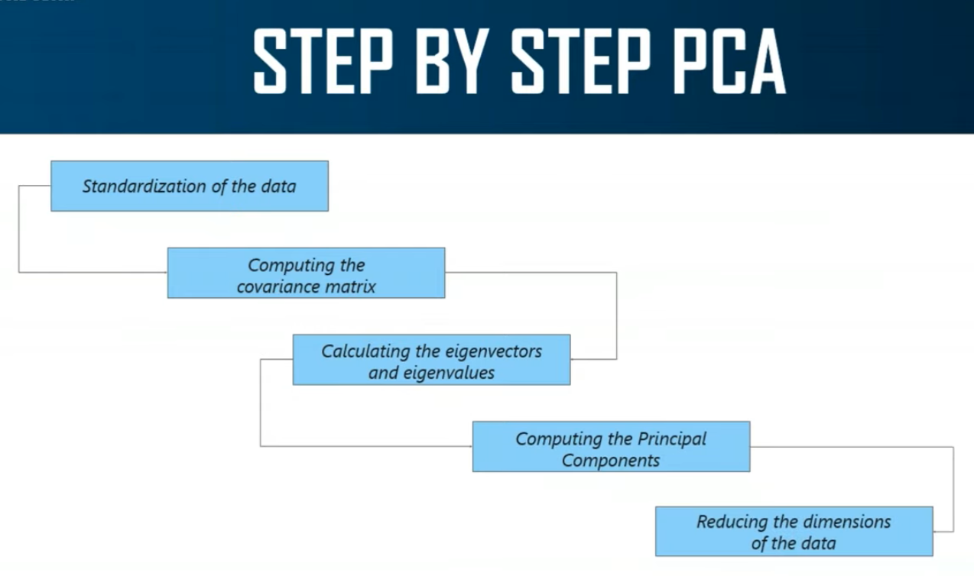

Slide 13
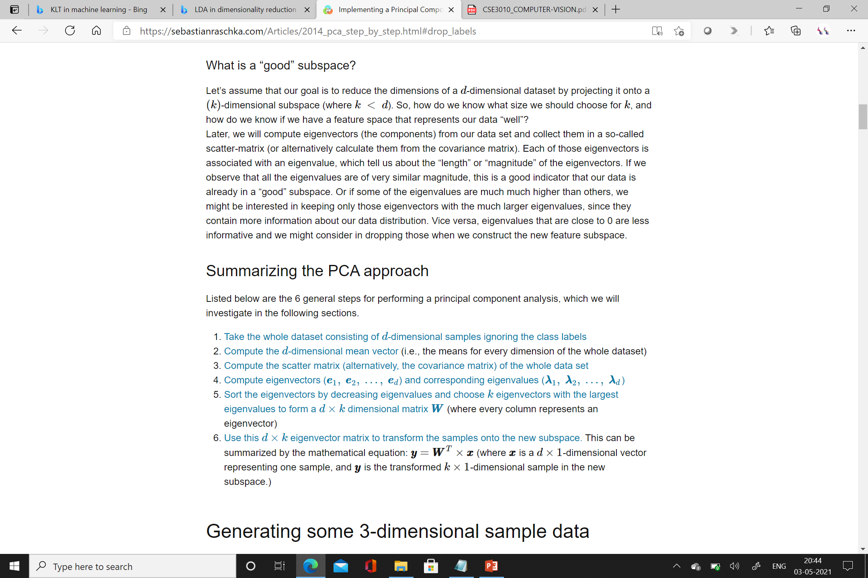

Slide 14
LDA
Linear Discriminant Analysis (LDA) is most commonly used as dimensionality reduction technique
Used in the pre-processing step for pattern-classification and machine learning applications.
The goal is to project a dataset onto a lower-dimensional space with good class-separability in order avoid overfitting and also reduce computational costs.

Slide 15
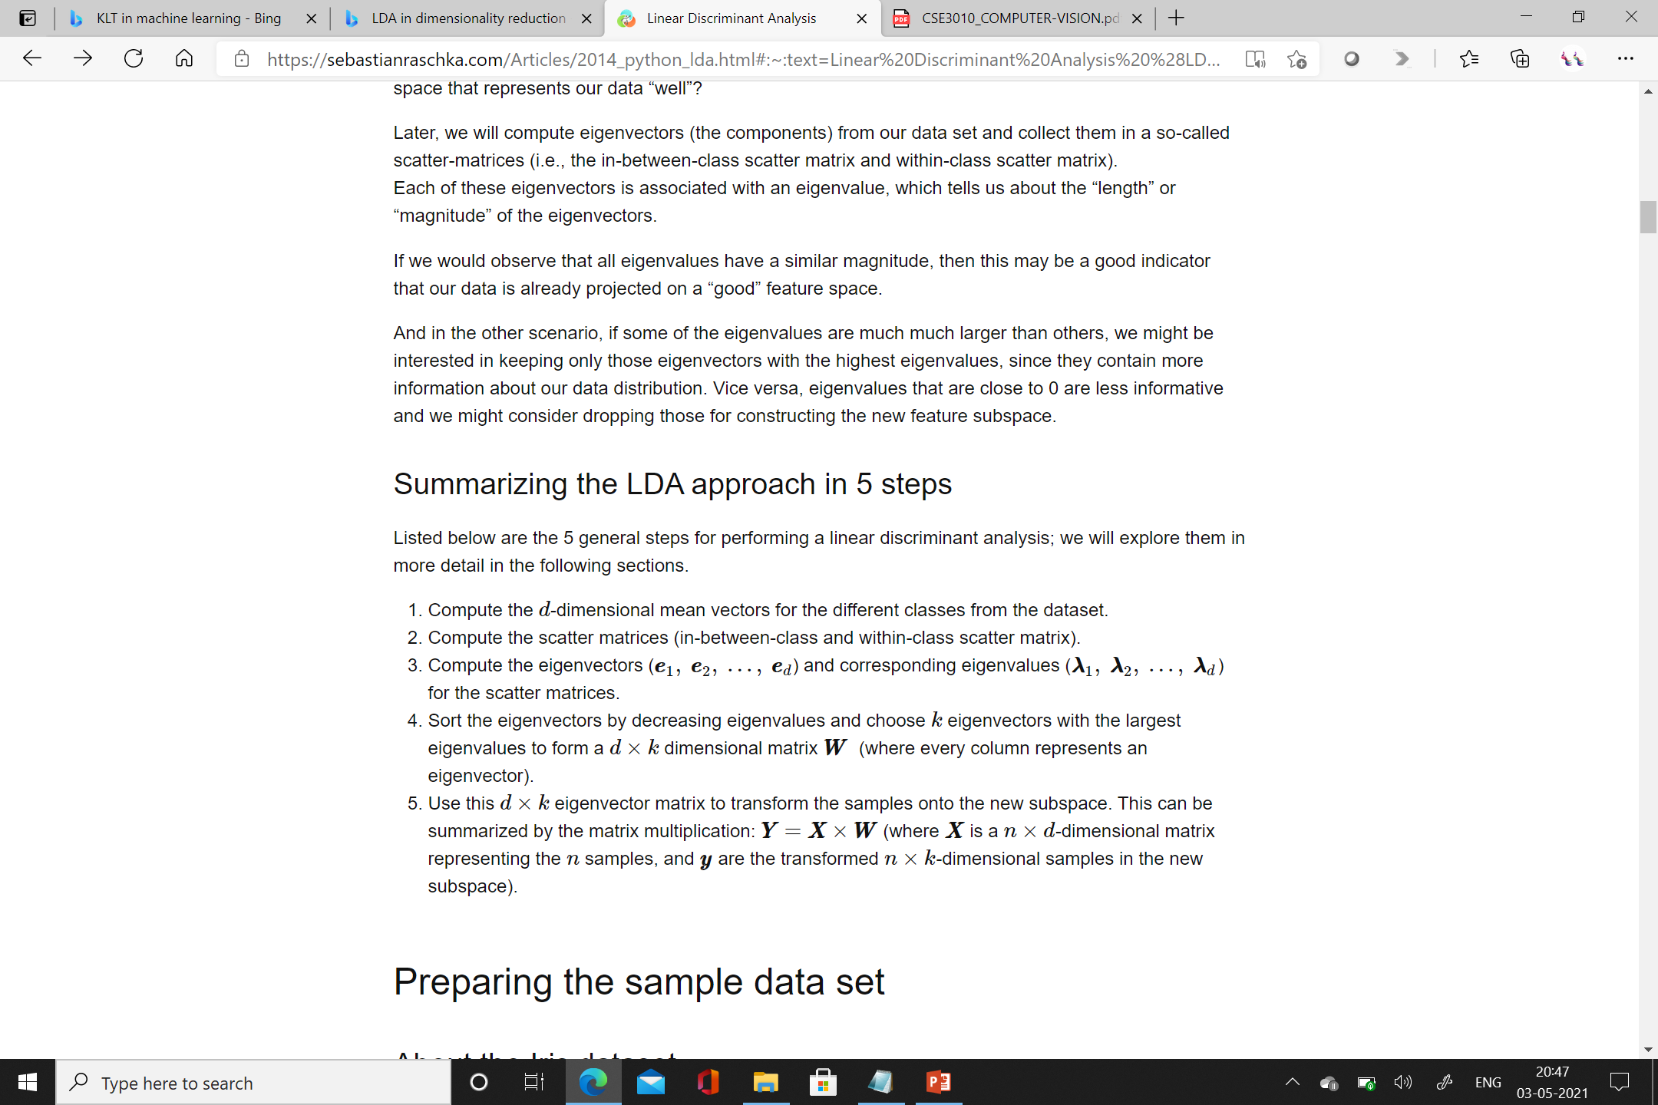

Slide 16
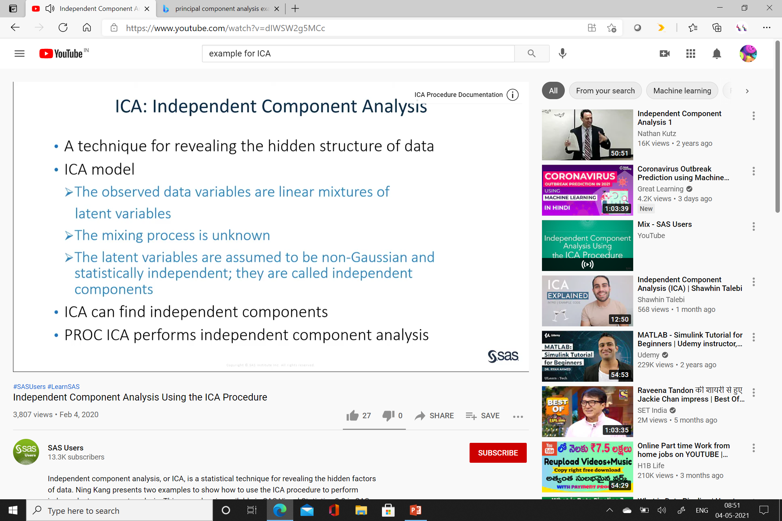
Independent component Analysis

Slide 17
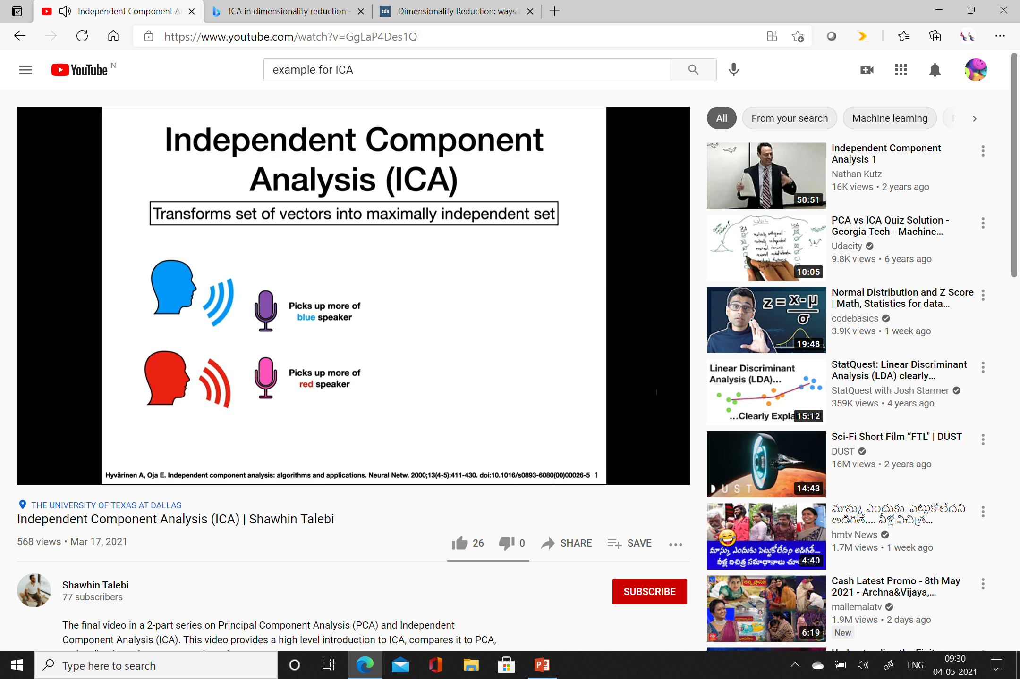

Slide 18
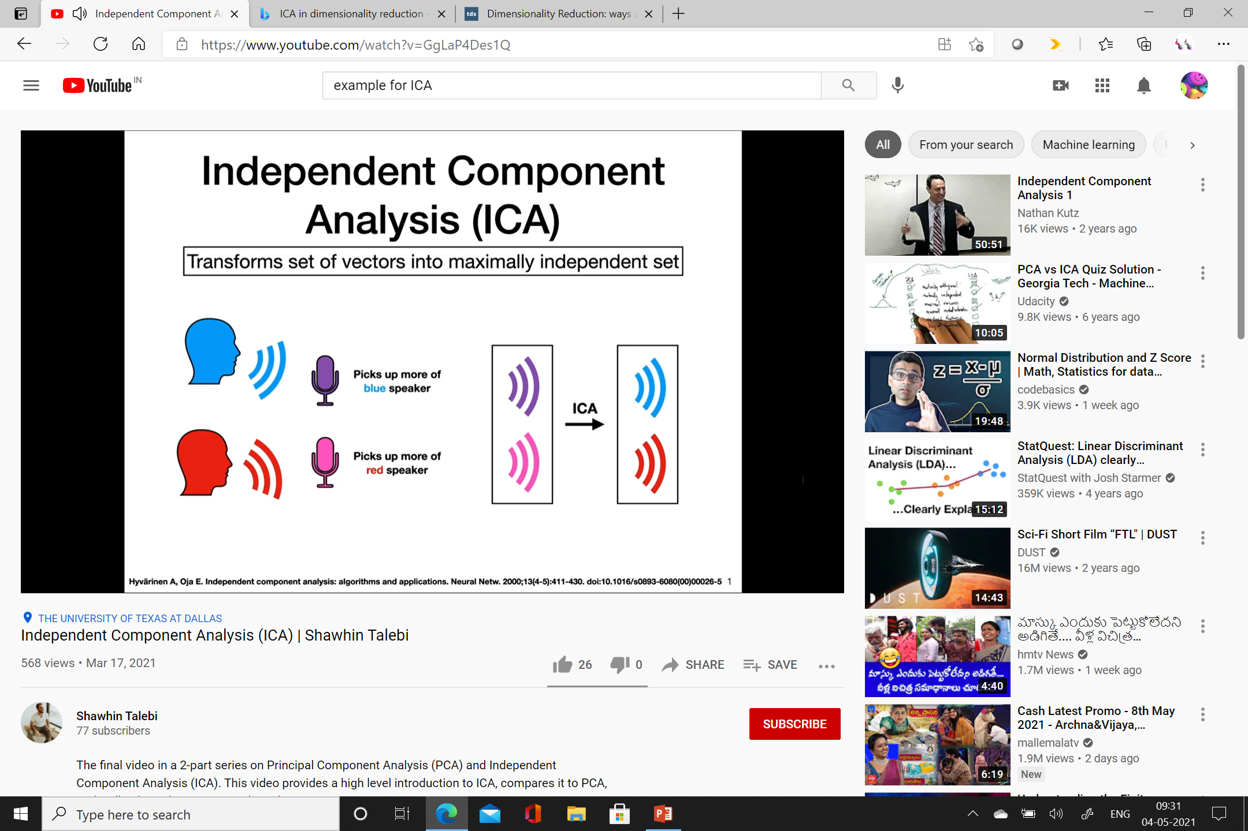

Slide 19
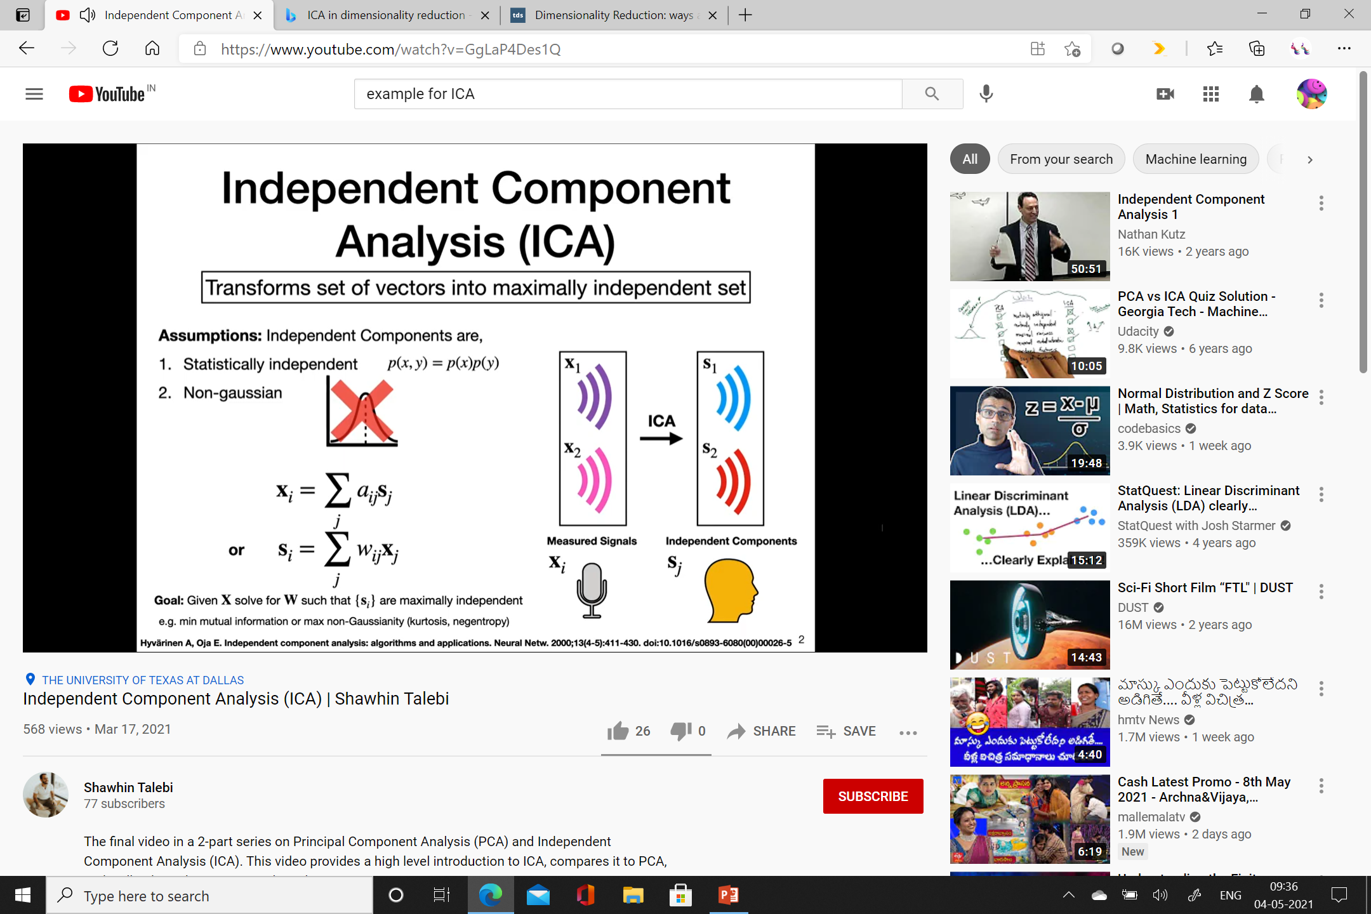

Slide 20
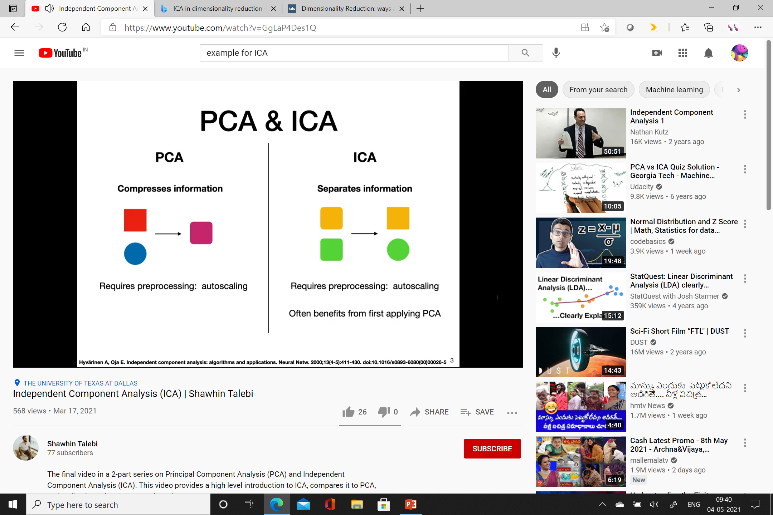

Slide 21
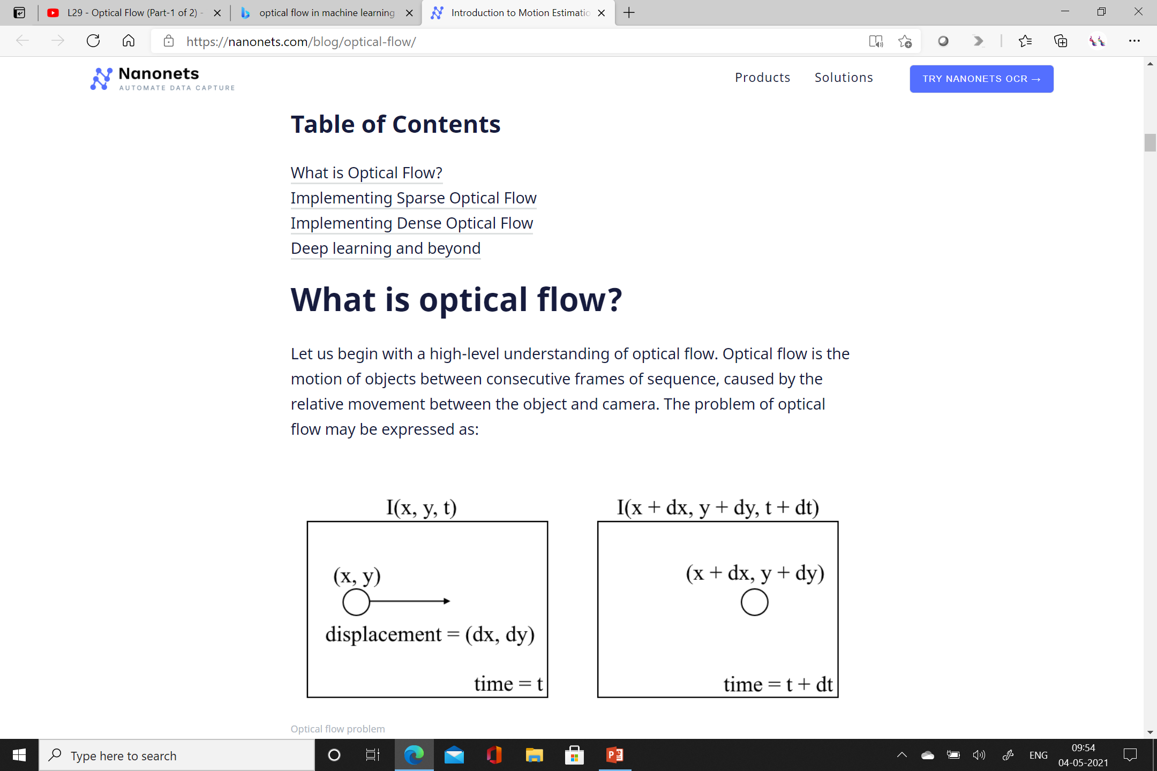
Optical Flow

Slide 22
between consecutive frames,
we can express the image intensity (I) as a function of space (x,y) and time (t).
In other words, if we take the first image I(x,y,t) and move its pixels by (dx,dy) over t time,
we obtain the new image I(x+dx,y+dy,t+dt).

Slide 23
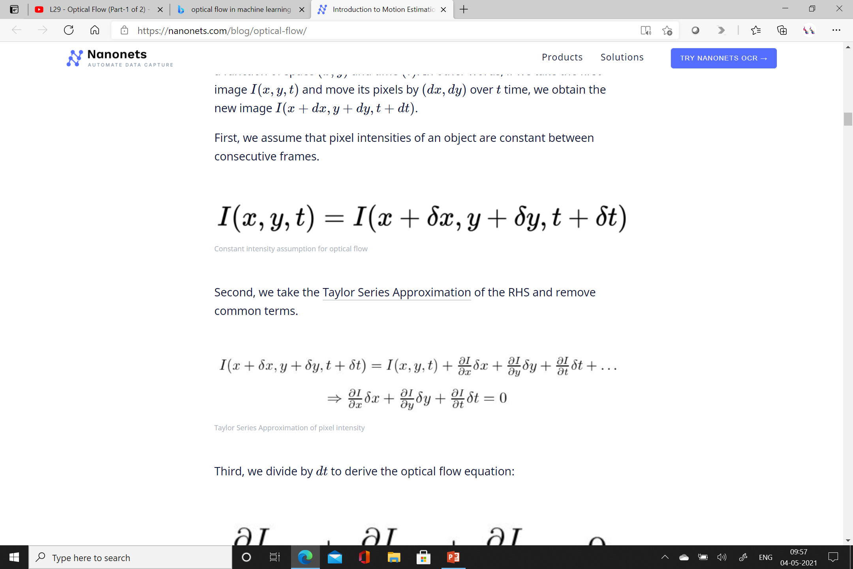

Slide 24
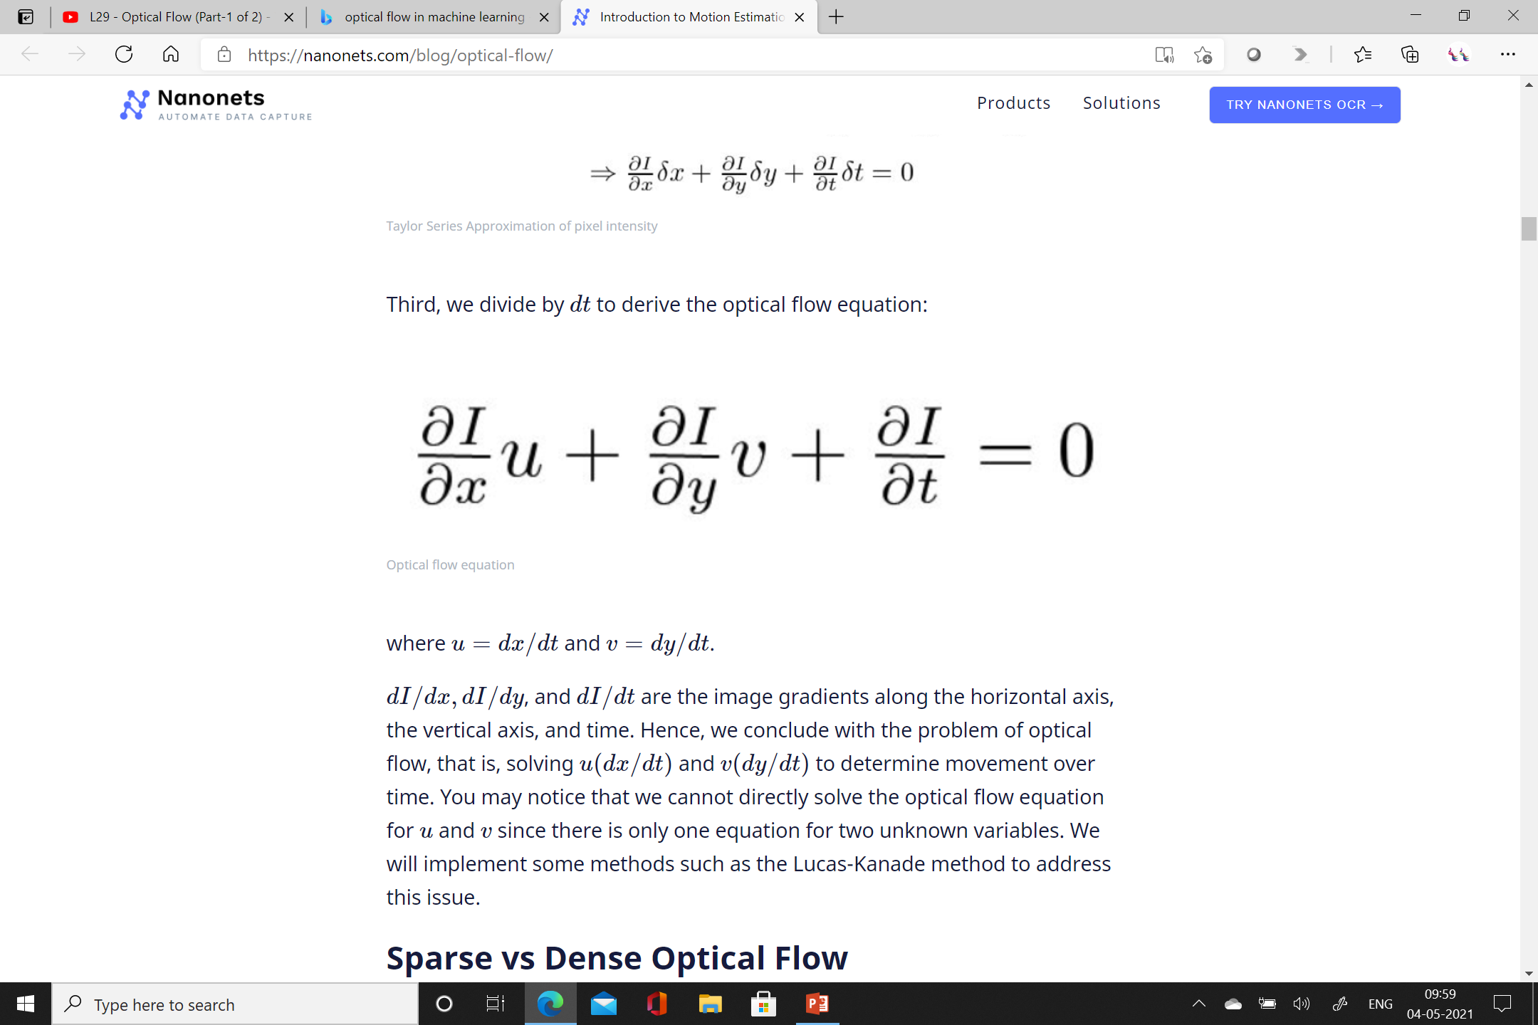

Slide 25


Slide 26
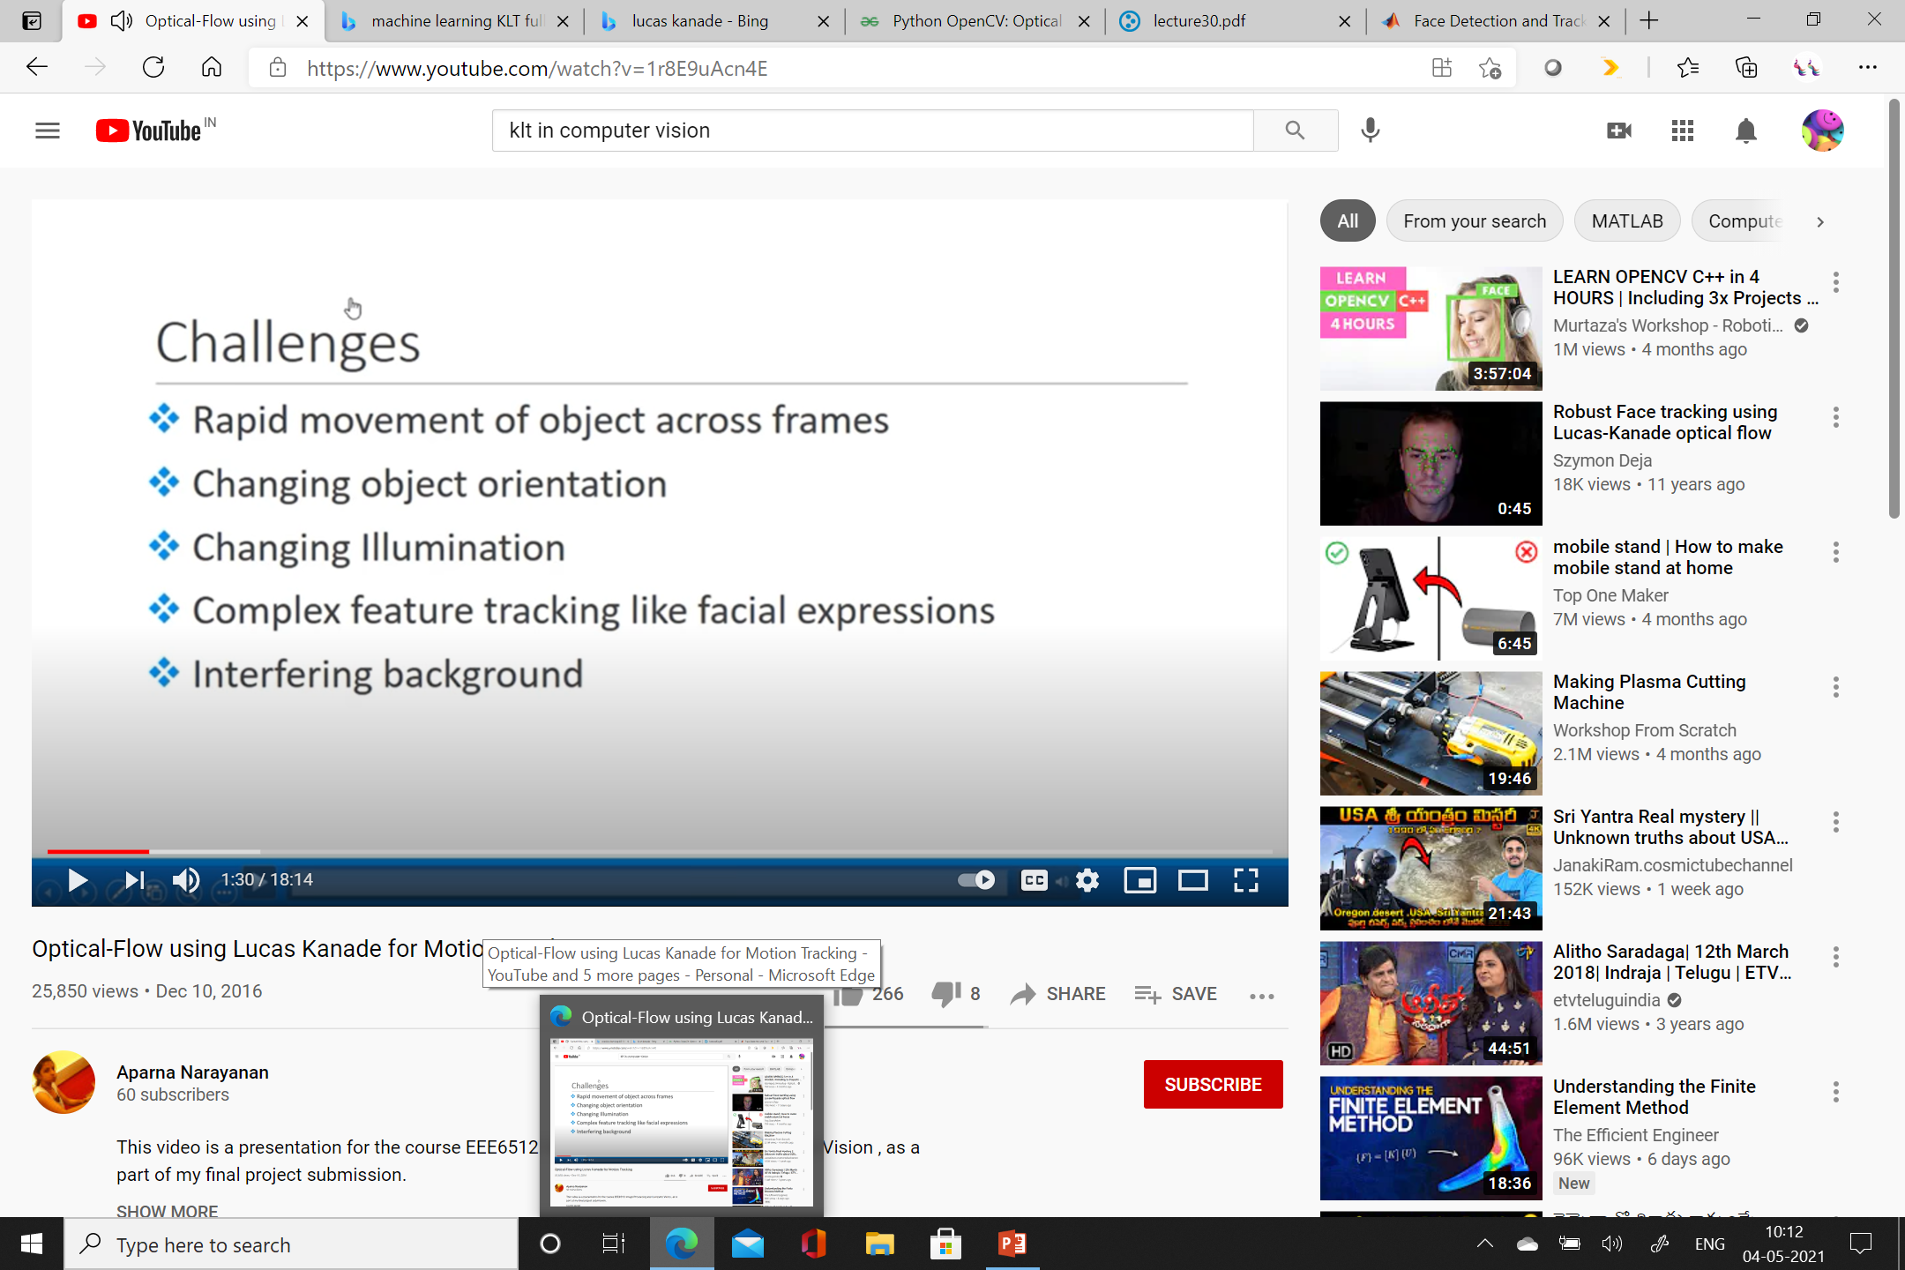

Slide 27


Slide 28
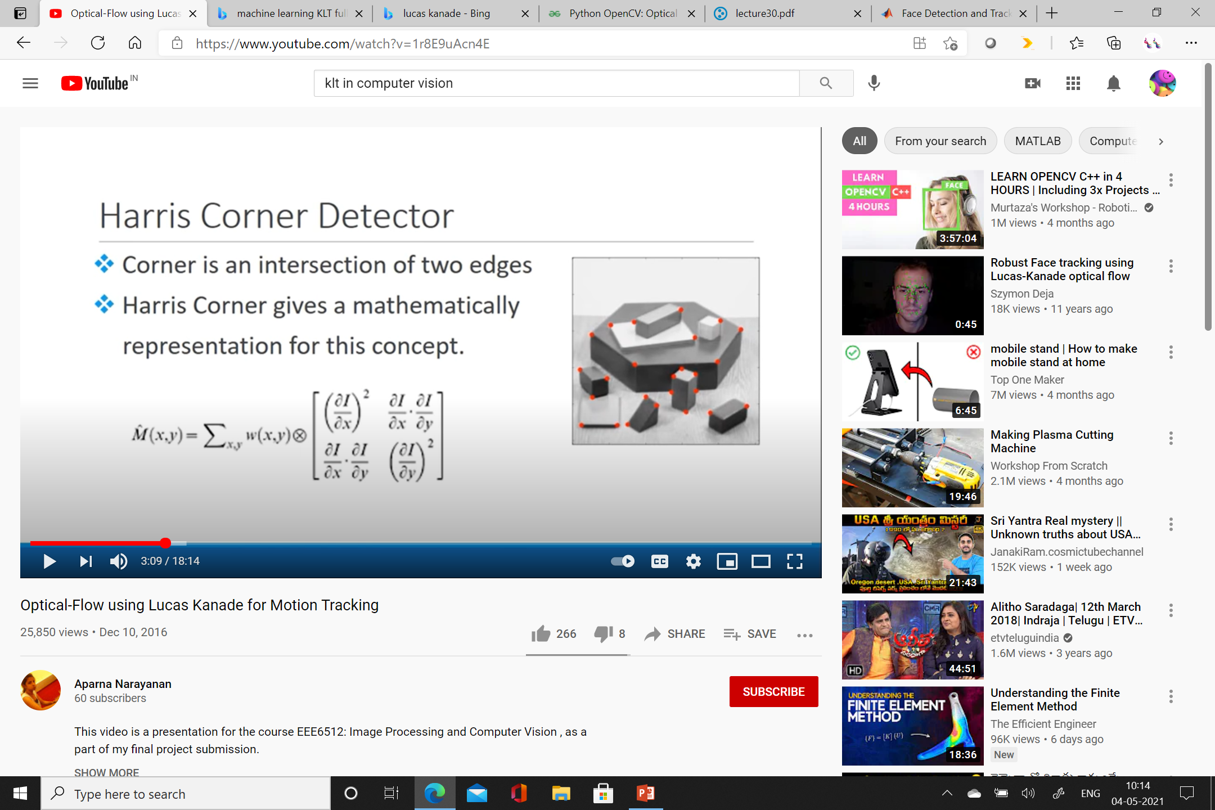

Slide 29
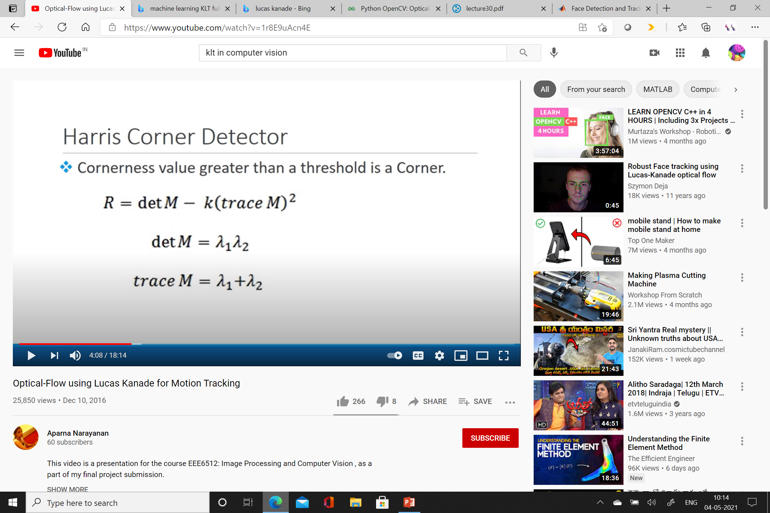

Slide 30


Slide 31


Slide 32
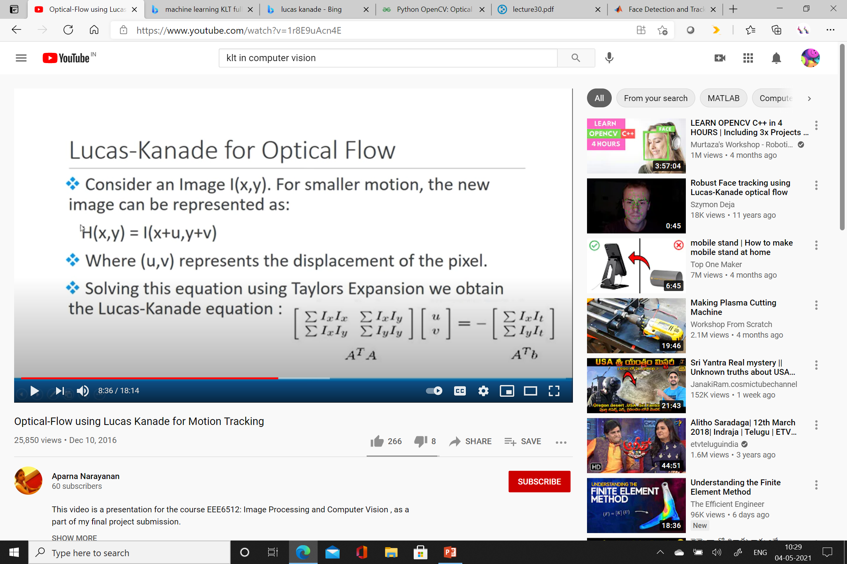

Slide 33
